Slide 1




Co-funded by
the European Union
SME POLICY INDEX
WESTERN BALKANS AND TURKEY 2022
ASSESSING THE IMPLEMENTATION OF
THE SMALL BUSINESS ACT FOR EUROPE
Launch of the publication
Dubrovnik Forum,
8 July 2022

Slide 2



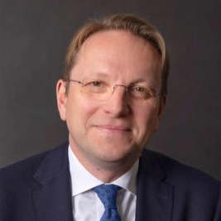



Launch of the SME Policy Index
Resilient Firms: Thriving in Uncertainty
Gordan GRLIĆ RADMAN
Minister of Foreign and European Affairs
Croatia
Ulrik VESTERGAARD KNUDSEN
Deputy Secretary-General of the OECD
OECD
Olivér VÁRHELYI (video message)
Commissioner
for Neighbourhood
and Enlargement
European Commission
Anita RICHTER
Acting Head of South East Europe Division
OECD
Jovana PAVLOVIC DJUKIC
Project Manager,
South East Europe Division OECD
Marijana PETROVIC
Project Manager,
South East Europe Division
OECD

Slide 3
Presentation outline
Sixth SME Policy Index cycle – economic context and the SME sector
SBA Assessment and the SME Policy Index
SME Policy Index: Western Balkans and Turkey 2022 – assessment results

Slide 4
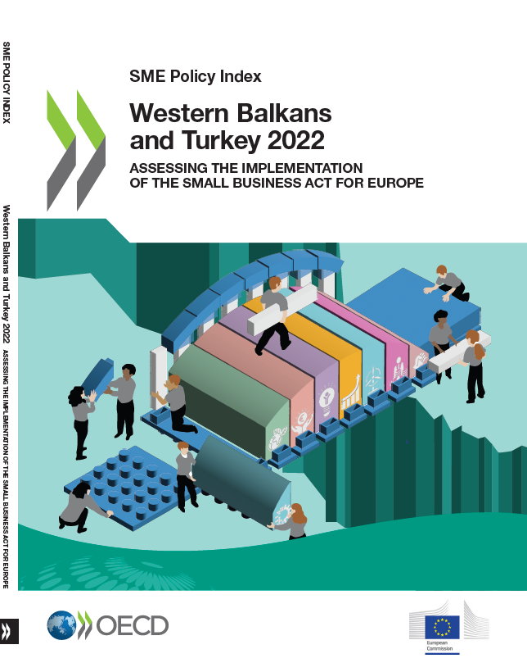
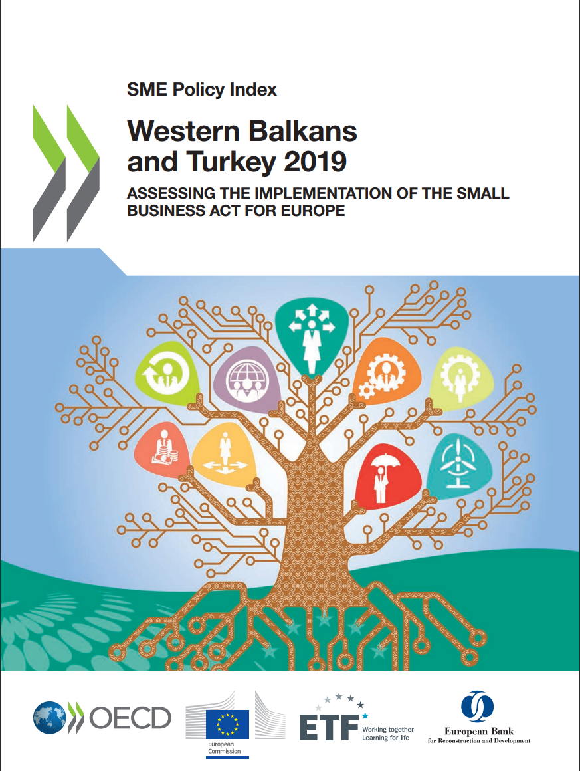
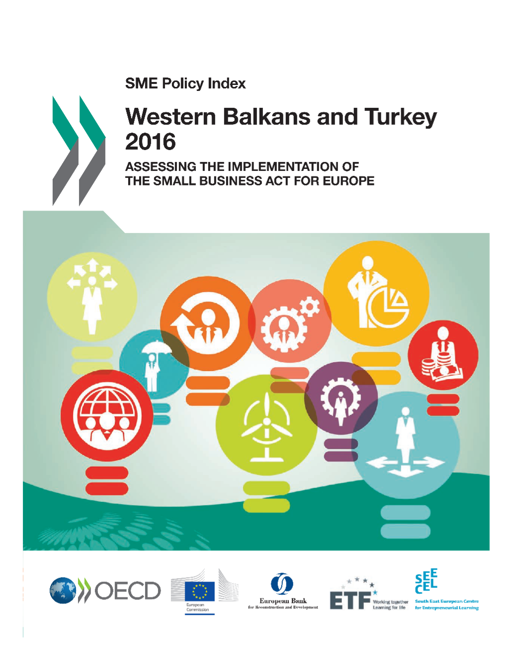
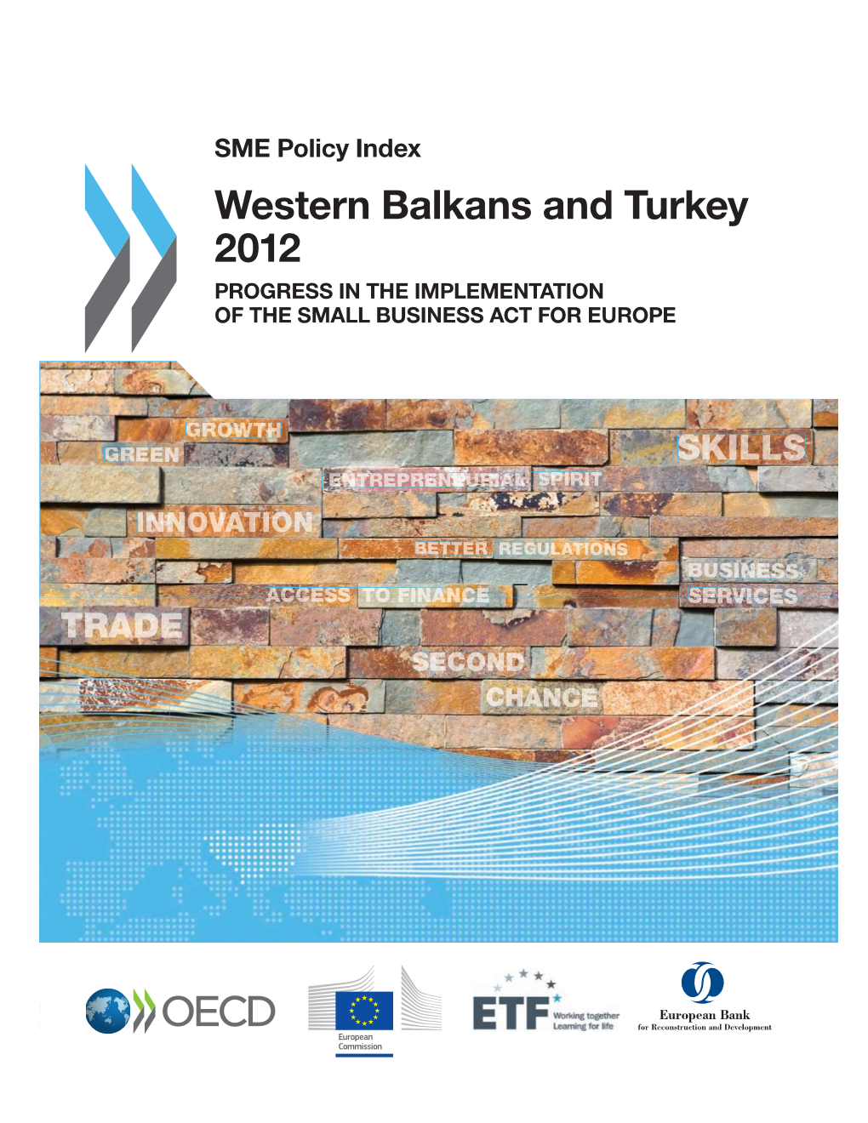
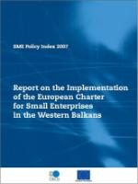

SME Policy Index – over 15 years of support to SME policy making
A benchmarking tool designed to assess policies that support SMEs and monitor progress in policy implementation over time.
Structured around the 10 principles of the Small Business Act (SBA) for Europe which allows for benchmarking not only between Partner Economies but also with EU Member States.
Assessment conducted every three years since 2007, allowing to measure progress and convergence towards OECD and EU good practice.
Used by the Western Balkan and Türkiye governments for their SME development strategy and other sectoral strategies (e.g. innovation, education, environmental protection) and the Economic Reform Programmes.
Aims to improve the business environment and to foster entrepreneurship and competitiveness.
The 2022 SBA Assessment – the sixth edition – was prepared in close collaboration with around 600 WBT government representatives and other SBA stakeholders, with support from the EC, EBRD and ETF.

Slide 5
To enhance the SME ecosystem, governments need to pay attention to the 10 SBA principles translated into 12 dimensions
1
RESPONSIVE GOVERNMENT
Dimension 3: Institutional and regulatory framework for SME policy making
Dimension 4: Operational environment for SMEs
Dimension 2: Bankruptcy and second chance for SMEs
2
ACCESS TO FINANCE
Dimension 6: Access to finance for SMEs
4
ENTREPRENEURIAL HUMAN CAPITAL
Dimension 1: Entrepreneurial learning and women’s entrepreneurship
Dimension 8a: Enterprise skills
3
SUPPORT MEASURES FOR SME COMPETITIVENESS
Dimension 5a: Support services for SMEs and start-ups
Dimension 5b: Public procurement
Dimension 8b: Innovation policy for SMEs
Dimension 9: SMEs in a green economy
5
SME INTERNATIONALISATION
Dimension 10: Internationalisation of SMEs
Dimension 7: Standards and technical regulations

Slide 6
Presentation outline
Sixth SME Policy Index cycle – economic context and the SME sector
SBA Assessment and the SME Policy Index
SME Policy Index: Western Balkans and Turkey 2022 – assessment results

Slide 7

The SME Policy Index cycle was marked by the COVID-19, which hit hard the economies and their SME sector
GDP growth rates declined sharply in 2020:
~50% of enterprises
82% of enterprises
8.4% of decline
had to discontinue their business activity due to COVID-19 as a result of reduced demand
reported losses in revenue compared to pre-COVID levels
in SMEs share in exports during the assessment period
Sources: Statistical offices, ministries and SME agencies of the six Western Balkan economies and Türkiye, SME Policy Index 2022, Unpublished OECD Western Balkans enterprise survey (2020)
*This designation is without prejudice to positions on status, and is in line with UNSCR 1244/1999 and the ICJ Opinion on the Kosovo declaration of independence.

Slide 8
Despite the strong impact, the SME sector rebounded fast supported by targeted government measures
Trend in increase of the number of SMEs per 1000 inhabitants that rose by 13.1% over the last couple of years wasn’t interrupted, indicating a possible improvement in the business environment:
+1.75%
Source: Statistical Offices of the six Western Balkan economies and Türkiye, European Commission, Annual Reports on European SMEs
Financial instruments
Deferral options
Loan guarantee
Income/ corporate tax
VAT
Social security and pension contributions
Rent/utilities/ local tax
Direct lending
Grants and subsidies
Government measures across the region have prevented a massive wave of business closures:
Notes:
About half of enterprises in the Western Balkans had to suspend their business activity temporarily due to
COVID-19. Nevertheless, the number of SMEs per 1000 inhabitants rose by 13% over the last couple of
years. Governments expanded their range of advisory services and trainings (including on digitalisation),
in order to help SMEs weather the crisis. Newly introduced or further strengthened credit guarantee funds
eased lending, while tax measures and debt moratoria relieved the debt burden.
This potentially points to an improved business environment, most notably to simplified procedures for starting a business and measures tackling informality, as well as to a maturing entrepreneurial culture. However, some caution is warranted in interpreting the data, as the scale of permanent business closures due to the COVID 19 crisis may yet to be fully reflected in official statistics.

Slide 9
Presentation outline
Sixth SME Policy Index cycle – economic context and the SME sector
SBA Assessment and the SME Policy Index
SME Policy Index: Western Balkans and Turkey 2022 – assessment results

Slide 10
2022 assessment results show improvements across policy areas
The strongest performance is in the areas of:
Dimension 3: Institutional and regulatory framework for SME policy making
Dimension 5a: Support services for SMEs
Dimension 5b: Public procurement
Dimension 7: Standards and technical regulations
Dimension 10: Internationalisation of SMEs
The most room for improvement is in the areas of:
Dimension 2: Bankruptcy and second chance
Dimension 8a: Enterprise skills
Dimension 8b: Innovation policy for SMEs
Dimension 9: SMEs in a green economy

Slide 11


SME greening
1. Responsive government
Well-developed SME strategies, inter-institutional co-ordination and M&E improved
Increased use of regulatory impact assessment (RIA) and public-private consultations (PPCs)
Enhanced digital government services for SMEs
Simplification and digitalisation of company registration processes
Comprehensive sets of tax measures introduced
Slight improvement in insolvency regimes
1
2
3
4
5
Bankruptcy and second chance
6
Way forward
Further advance the institutional and regulatory frameworks
Ensure that digital government reforms deliver digital services relevant and responsive to the needs of SME
Enhance efforts to improve bankruptcy policies
Institutional and regulatory framework
6 WBT economies
3 out of 7
WBT economies
conduct aggregate reporting on PPCs across different line ministries to measure their quality and consistency
enable electronic registration of companies (up from 3 in 2019)
Operational environment
Source: Findings from the forthcoming SME Policy Index 2022.

Slide 12


SME greening
2. Access to finance
1
Financial intermediation remained resilient → SME lending eased
Private sector credit grew noticeably
Non-bank financial instruments
Venture capital remains in the early stages
Financial literacy still to advance
2
3
4
5
a
55% of GDP
Way forward
the share at which stood private sector credit in 2020, a 6 p.p. increase since 2016
Increase access to bank lending
Transition temporary COVID-19 credit guarantee funds into a more permanent support mechanism
Raise awareness about the opportunities of alternative finance to ensure uptake, especially of factoring
Further build on efforts to create an environment conducive to venture capitalists
Introduce or renew strategic frameworks to enhance financial literacy
a
4.2% of gross loans
were non-performing loans in 2021, compared to 10.4% in 2016
Sources: 1) World Bank; 2) CEIC data, BEEPS

Slide 13
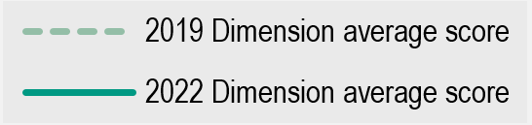


3. Support measures for SME competitiveness
1
Publicly provided BSSs improved in range and scope
Public procurement legislation now enhances SME participation
Efforts to build an innovation ecosystem are progressing
SMEs greening is further encouraged
2
3
Support services for SMEs
4
Way forward
Better match the supply of BSS with the SMEs’ needs
Continue addressing barriers that limit SMEs’ participation in public procurement
Further recognise SMEs as key players for innovation-based economies
Develop a wider range of tools to support SME greening
Public procurement
Innovation policy for SMEs
0.6% of GDP
25% of SMEs on average
is spent on R&D across the region, well below the EU target of 3%.
offer green products or services,
a 5 percentage point increase since 2018.
Sources: 1) UNESCO Institute for Statistics; 2) Eurobarometer.
SMEs in a green economy

Slide 14


4. Entrepreneurial human capital
1
Entrepreneurial learning is increasingly recognised as a priority
Enterprise skills training provision broadened
Women’s entrepreneurship is an untapped source of economic growth
2
3
Way forward
Entrepreneurial learning and
women’s entrepreneurship
Further enhance entrepreneurial learning among young people
Place a priority on SME training that supports sustainable development and green transition
Further promote and support women’s entrepreneurship
GDP could rise by
20%
66% of OECD’s
Enterprise skills
if women were involved in the labour market at the same level as men.
recommendations in the area of entrepreneurial human capital have been implemented since 2019.
Sources: 1) World Bank data for Western Balkans; 2) Findings from the forthcoming SME Policy Index 2022.

Slide 15


SME greening
5. SME internationalisation
1
Rise in adoption rates of EU standards and harmonization of technical regulations
Efforts to increase SME export volume and participation in GVCs
Accelerated adoption of digital technologies and e-commerce use by SMEs
Outstanding challenges with performance-based monitoring and evaluation of policies and programmes
2
3
4
Standards and technical regulations
Way forward
Improve SME access to standardisation
Intensify efforts to improve the productivity of SMEs and to broaden the economies’ supplier base
Strengthen monitoring and evaluation mechanisms
Approximately 60%
The adoption rate of EU standards and technical regulations among WBT economies rose from
Internationalisation of SMEs
of region’s exports is directed towards the EU
91% in 2019 to 94% in 2022
Sources: 1) Data from CEN-CENELEC, OECD calculations without Kosovo*as adoption rates are not monitored or reported by CEN-CENELEC; 2) Eurostat.

Slide 16

Co-funded by
the European Union
Thank you for your attention!
For further information please contact:
Available on the OECD iLibrary as of 8 July
Jovana PAVLOVIC DJUKIC
Project Manager of the SME Policy Index 2022
OECD South East Europe Division
e-mail: jovana.pavlovicdjukic@oecd.org
Marijana PETROVIC
Project Manager of the SME Policy Index 2022
OECD South East Europe Division
e-mail: marijana.petrovic@oecd.org

